Slide 1
Apache PIG

Slide 2
Apache Pig – History
In 2006, Apache Pig was developed as a research project at Yahoo, especially to create and execute MapReduce jobs on every dataset.
In 2007, Apache Pig was open sourced via Apache incubator.
In 2008, the first release of Apache Pig came out.
In 2010, Apache Pig graduated as an Apache top-level project.

Slide 3
Introduction
It is an abstraction over MapReduce.
It is a tool/platform which is used to analyze larger sets of data representing them as data flows.
we can perform all the data manipulation operations in Hadoop using Apache Pig.
Pig Latin language provides various operators using which programmers can develop their own functions for reading, writing and processing data.
To analyze data using Apache Pig, programmers need to write scripts using Pig Latin language. All these scripts are internally converted to Map and Reduce tasks.
Apache Pig has a component known as Pig Engine that accepts the Pig Latin scripts as input and converts those scripts into MapReduce jobs.

Slide 4
Needs of Apache Pig
Using Pig Latin, programmers can perform MapReduce tasks easily without having to type complex codes in Java.
Apache Pig uses multi-query approach, thereby reducing the length of codes.
Pig Latin is SQL-like language and it is easy to learn Apache Pig when you are familiar with SQL.
Apache Pig provides many built-in operators to support data operations like joins, filters, ordering, etc. In addition, it also provides nested data types like tuples, bags, and maps that are missing from MapReduce.

Slide 5
Features of Pig
Rich set of operators: It provides many operators to perform operations like join, sort, filer, etc.
Ease of programming: Pig Latin is similar to SQL and it is easy to write a Pig script if you are good at SQL.
Optimization opportunities: The tasks in Apache Pig optimize their execution automatically, so the programmers need to focus only on semantics of the language.
Extensibility: Using the existing operators, users can develop their own functions to read, process, and write data.
UDF’s: Pig provides the facility to create User-defined Functions in other programming languages such as Java and invoke or embed them in Pig Scripts.
Handles all kinds of data: Apache Pig analyzes all kinds of data, both structured as well as unstructured. It stores the results in HDFS.

Slide 6
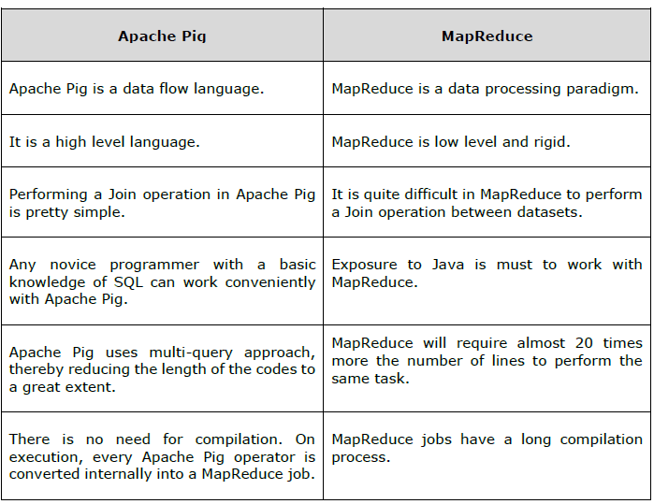
Apache Pig Vs MapReduce

Slide 7
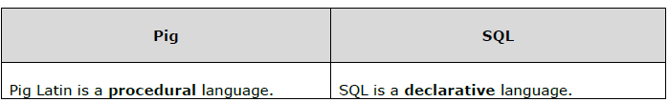
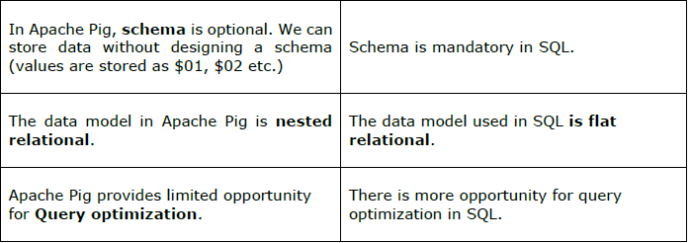
Apache Pig Vs SQL

Slide 8
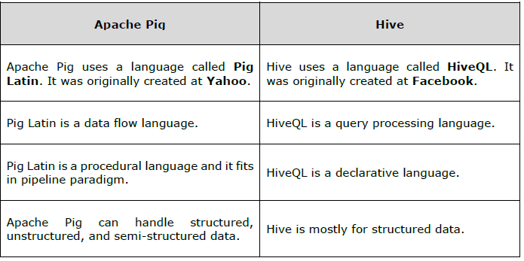
Apache Pig Vs Hive

Slide 9
Applications of Apache Pig
Apache Pig is generally used by data scientists for performing tasks involving ad-hoc processing and quick prototyping.
To process huge data sources such as web logs.
To perform data processing for search platforms.
To process time sensitive data loads.

Slide 10
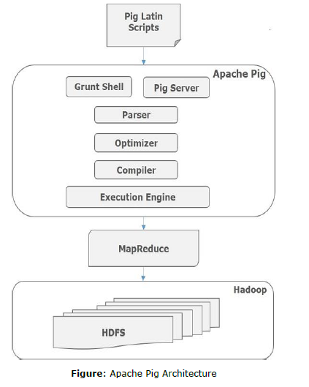
Apache Pig – Architecture

Slide 11
Apache Pig Components
Parser : Initially the Pig Scripts are handled by the Parser. It checks the syntax of the script, does type checking, and other miscellaneous checks. The output of the parser will be a DAG (directed acyclic graph), which represents the Pig Latin statements and logical operators.
In the DAG, the logical operators of the script are represented as the nodes and the data flows are represented as edges.
Optimizer : The logical plan (DAG) is passed to the logical optimizer, which carries out the logical optimizations such as projection and pushdown.
Compiler : The compiler compiles the optimized logical plan into a series of MapReduce jobs.
Execution engine: Finally the MapReduce jobs are submitted to Hadoop in a sorted order. Finally, these MapReduce jobs are executed on Hadoop producing the desired results.

Slide 12
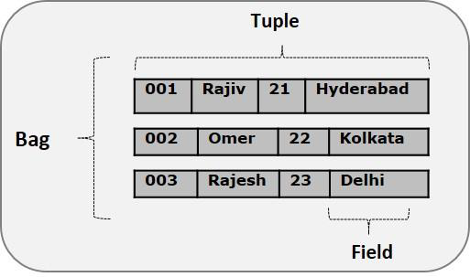
Pig Latin – Data Model
The data model of Pig Latin is fully nested and it allows complex non-atomic datatypes such as map and tuple.

Slide 13
Pig Latin – Data Model
Atom: Any single value in Pig Latin, irrespective of their data, type is known as an Atom. It is stored as string and can be used as string and number. int, long, float, double, chararray, and bytearray are the atomic values of Pig.
A piece of data or a simple atomic value is known as a field.
Example: ‘raja’ or ‘30’
Tuple : A record that is formed by an ordered set of fields is known as a tuple, the fields can be of any type. A tuple is similar to a row in a table of RDBMS.
Example: (Raja, 30)

Slide 14
Pig Latin – Data Model
Bag : A bag is an unordered set of tuples. In other words, a collection of tuples (non-unique) is known as a bag. Each tuple can have any number of fields (flexible schema). A bag is represented by ‘{}’. It is similar to a table in RDBMS, but unlike a table in RDBMS, it is not necessary that every tuple contain the same number of fields or that the fields in the same position (column) have the same type.
Example: {(Raja, 30), (Mohammad, 45)}
A bag can be a field in a relation; in that context, it is known as inner bag.
Example: {Raja, 30, {9848022338, raja@gmail.com,}}

Slide 15
Pig Latin – Data Model
Relation: A relation is a bag of tuples. The relations in Pig Latin are unordered (there is no guarantee that tuples are processed in any particular order).
Map: A map (or data map) is a set of key-value pairs. The key needs to be of type char array and should be unique. The value might be of any type. It is represented by ‘[]’
Example: [name#Raja, age#30]

